Slide 1
17-612 Fall 2023
Business & Marketing Strategy
Class 5
Jim Berardone
Associate Professor of the Practice of Product Management

Slide 2
You have a product idea …that’s supports the company strategy and product line strategy
Next: determine its market and competition.

Slide 3
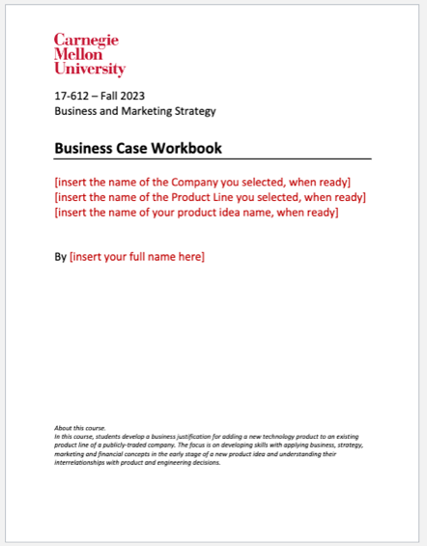
Product Assignment No. 3 Markets and Competitive Position
Due Tue Sep 19 at start of class
Section 5. Market
1. Target Market
2. Target Market Segments
3. Market Strategies
Section 6. Competitive Positioning
Product Category
Competition
Positioning
today
There are readings and examples on Canvas
– “Post Class Activity”
– with the Assignment

Slide 4
Why is it important for Product Managers, Engineers and Designers to have a target market and to know the competition?

Slide 5
It’s important because they’re needed
…to direct their limited resources (time, money, etc.) on the most promising potential customers and users of a product.
…to build a persuasive business case for an idea
e.g., estimating revenue and costs
…to make product, design and engineering decisions

Slide 6
You’ll need the target market and competition to make “marketing-mix” decisions.
Product
Price
Place
Promotion
Offer
Segmentation
Targeting
Positioning
“STP process”
“the 4 P’s Marketing-Mix”
Image Source: https://www.canstockphoto.com/

Slide 7
Target Market

Slide 8
Definition: Target Market
A particular group of customers at which a product, service or program is aimed.

Slide 9
Identifying your target market
Start with the potential users. Who is most likely to use the product?
The users are most critical for making many product decisions.

Slide 10
Identify a representative “class” of potential users, NOT a specific person and NOT an organization.
Product Idea | User
Online tutoring service | Student
Marketing campaign software | Marketeer
Bicycle | Bicyclist
Credit card | Cardholder
Whiteboard | Teacher
a.k.a.
Actors in Software Engineering. Personas elsewhere.
Notes:
Smartphone user
Learning Management System
Search engine

Slide 11
In some cases, there are multiple users.
Product Idea | User
Ride hailing service | Passenger
 | Driver
Online store | Shopper
 | Merchant
Electric Vehicle | Vehicle Owner (or, Driver)
 | Passengers
Don’t aim to be comprehensive for making a business case.
Choose the most relevant user(s) for estimating revenue, expenses and making product, pricing and marketing decisions.
Notes:
Smartphone user
Learning Management System
Search engine

Slide 12
For B2B ideas, job titles are very useful.
For B2C ideas, you may need to be creative.
B2B Product idea | User
Software Architecture design tool | Software Architects
Applicant Tracking software | Recruiting Managers
Small Business Accounting software | Business owner
B2C Product idea | User
Online apparel store | Apparel shoppers
Remote child monitoring app | Working parents
Home internet service | Homeowners
Smartphone | Mobile device users
B2B= products sold from business-to-business, organizations. B2C = product sold from business-to-consumers
Notes:
a.k.a. ”Actor” in software engineering, “Persona” in other fields.
Examples - B2B, B2C (online apparel shoppers) – see students’ ideas
How to find (alternative terms)
Primary, secondary
Exercise: Identify your user. All, then select. (Quick search for size; estimate.)
Size: No. Users. (Later, No. Uses.) Possibly no. devices. Example: No Trips booked.
- How many potential users are there? How many would use it?
– Potential revenue, potential units sold, tech/architectural
Find no. existing customers, users

Slide 13
Take 2 minutes. Identify the most relevant potential user(s) for your product idea.

Slide 14
How many potential users are there?
Find or estimate the number of people in the world who match the representative user.
You’ll likely use this to:
- estimate revenue and expenses
- make marketing-mix decisions including product design and development

Slide 15
Example:
User = college student
Target Market = College Student market
Estimated Size
= 220M college students globally
(19M in USA)
Source (USA): National Center for Education Statistics
Source (global): World Bank.

Slide 16
Example:
User = product manager
Market = Product Manager market
Estimated Size
= 1.2M product managers globally (669K in USA)
Source: LinkedIn (job titles search)

Slide 17
TIPS
For many software and device products, the number of potential users is very useful.
Examples:
iPhone
Office 365
Revenue and Expenses are likely to be tied to the number of users or product usage
For some products, the number of potential users is not so useful:
How many potential units could be sold?
Examples:
Air conditioning equipment for office buildings
Might use the no. office buildings + average square foot space per building
Robotic Painting System for cars
Might use the no. vehicles manufactured per day

Slide 18
Target Market Segmentation

Slide 19
But…everyone in a market is not alike.
It is rarely possible to satisfy all customers in a market by treating them alike with the same product, pricing, marketing and places to purchase it.
Image source: https://www.maxpixel.net/Human-Silhouettes-Crowd-Group-Of-People-Personal-2718833

Slide 20

You want to segment the market in a way that is most useful and insightful for product decisions
Product decisions
Which products and features do we need to create?
How will we differentiate our product versus the competition?
Pricing decisions
- What price should we charge?
Each market segment should have users who are similar, but in a way that is different than other segments.
Picture Source: http://www.sctcc.edu/target

Slide 21


Less is More.
Mass marketing to the total market:
treat all customers in the market the same
use the same marketing mix (4P’s) for everyone
can be more cost effective
Targeted marketing to market segments:
recognizes the diversity of customers in a market
uses a specific marketing mix for specific customer segments
can be more competitive and profitable
Customers are more satisfied
Image sources: http://www.123rf.com and http://hrandtalent.com/tag/simon-parkin/

Slide 22
For example: Microsoft Excel
The product’s usage rate of its customers was a key dimension to segment its market and satisfy its customers better.
This led to product decisions:
- Menus for light usage customers
- Shortcut keys for moderate usage customers
- Macros for heavy usage customers

Slide 23
5 Key elements to defining each market segment.
Market Segment Name
A name for the market segment that uniquely and clearly identifies it.
Segmentation Variable(s)
The market segmentation variables you are using to divide the target market into groups (segments)
Segmentation Values
The value(s) for each variable that you’re using to define the market segment.
Segment Size
What is the estimated size? How many potential users are in this segment?
Segment Growth Rate
What is the rate that the size of this segment is changing? Is it declining, steady, growing fast, growing hyper-fast?

Slide 24
Example: Market Segment Definition for forklift truck product
Market Segment Definition
Target Market: Forklift drivers (2.6 M worldwide)
Segmentation Variable(s) | Use Case. Geographic Location.
Segmentation Values | Palletized loads USA | Cart loads USA | Palletized loads Asia | Cart loads Asia
Segment Name | US Pallet drivers | US cart drivers | Asia Pallet drivers | Asia Cart drivers
Segment Size | 1.3M | 0.2M | 0.7M | 0.4M
Segment Growth Rate | About 2 % / year | About 2 % / year | Faster than USA | Slower than USA

Slide 25
Example: Product Idea = electric scooter (former student, several years ago)
Target Market = Urban Commuters | Values
 | Segment 1 | Segment 2 | Segment 3
Segment Name | “Yuppies” | “Retirees” | “College Students”
Geographic location | USA | USA | USA
Status | Young Professional | Retired | Higher-Education Students
Variables
Values
The former student consider many ways before selecting these 3 segments to target.

Slide 26
The student could have (should have) segmented like this:
Urban Commuter Market | Values
 | Segment 1 | Segment 2 | Segment 3
Segment Name | Solo Riders | Solo Riders with Packages | Tandem Riders
Geographic | USA | USA | USA
Age Group | Young adults (19-39) | Young adults (19-39) | Young adults (19-39)
Use Case | Travelling alone | Travelling with packages | Travelling with a passenger.
Possibly, a more attractive market than Retirees.
There’s likely to be more significant differences in product features (or even different products) for each segment, and pricing, marketing and selling decisions.

Slide 27
Template: Market Segment Definition The result of your segmentation decisions
You can this template or use your own format.
Market Segment Definition
Target Market
Segmentation Variable(s)
Segmentation Values
Segment Name
Segment Size
Segment Growth Rate
Optional for your assignment.

Slide 28
There are 5 types of segmentation variables to use
1.
2.
4.
5.
‘Firmographic’
– used for B2B products.
3.

Slide 29
Behavioral segmentation variables are most useful for product decisions
Use Case (different circumstances lead to different product decisions.)
Usage Rate (a.k.a. Consumption Rate) (High use, normal use, low use. Heavy use, moderate use, light use. Frequent use, occasional use, infrequent use.)
User Status (1st time user, regular user, etc.)
Problems (different causes affect different customers)
Desired outcomes (different outcomes lead to different problems and solutions)
Degree of User Sophistication (high, medium, low.)
Level of customization required (lots, little, none…)
Purchasing criteria (e.g. compatibility with X; recyclability)
Purchasing procedure (e.g. transactional buyers; subscription; store buyers; online buyers)

Slide 30
The other 4 types of segmentation variables
2.Demographic
Age
Gender
Education
Income
Nationality
Religion
Ethnicity
Family Life cycle stage
Family size
Job Status
Generation
Language
3. ‘Firmographic’
Occupation / Job Title or Role
Industry
Customer Size:
e.g., Small Biz, Mid-size, Large, Top Tier
Company Department
4. Geographic
World region
Country
Metro or City
Climate
Density (urban, suburban,…)
5. Psychographic
Lifestyle
Social class
Personality
Activities/Hobbies
Interests
Opinions
Values
Attitudes, Beliefs
Causes
Cultures

Slide 31

It’s common to use several variables of multiple types to define a market segment.
A market segment is defined by the variables and values that are used.

Slide 32
Exercise
For your product idea and target market (users):
Identify 1 variable that could help to divide your market into groups (segments)
Identify at least 2 values for each variable
If you have time, select another variable and 2+ values
Segmentation Variable
Segmentation Values

Slide 33
There are 6 criteria (rules) each market segment definition must satisfy to be valid.
Homogeneous – the customers in each segment are the same as much as possible
Distinctive – the customers each segment are different from the customers in the other segments as much as possible (EXCEPT when segmenting by use case.)
Measureable – you can estimate the size with reasonable accuracy for making decisions
Substantial – the number of customers in the segment is sufficiently large to be feasible
Accessible – you can easily find the customers or they can easily find you
Actionable – you can use it to make decisions
Market A
Segment 1
Segment 2
Segment 3
Segment N

Slide 34
Data Sources for Market Segmentation & Sizing
Course Library
“Market/Industry Info”
Gartner Core Research
Frost & Sullivan
Google Search
How many ___ are there in the USA?
Statista.com
80K statistics from 10K sources
LinkedIn
Number of professionals with a job title
Search variations
Current vs. past positions
Professional Associations and Societies
Often have numbers of people in their profession
Facebook advertising
Can identify no. of FB users matching a certain profile for a marketing campaign

Slide 35
Sizing a market segment

Slide 36
Sizing a market segment
How many potential users are there in the segment?
Find or estimate using logic, assumptions and/or data.
Make sure the number is consistent with YOUR definition of the market segment (variables and values.)
You may have to revise the number to fit your definition
You might choose to change your definition to fit the sizing.

Slide 37
Use a top-down or bottom-up approach
Top-down
Start with a Market size by finding / estimating the number of people who fit your targeted user.
Strip away segments of this market that are not part of the segment you’re sizing
Use numbers that you can find or assume percentages
The remainder is your target market size for the segment
Market
Segment 1
Segment 2
Segment 3
Bottom-up
Start at or below the segment level.
Find / estimate the number of people who
fit the segment definition
or, fit part of the segment definition
or, the number of customers of competitive products.
Build up by adding people that are not part of the above number but fit your market segment definition.
The result is your target market size for this segment.
Notes:
TIP: Try to find the number of customers of competitive products for the JTBD.

Slide 38
Example: electric scooter idea (former student) Estimated size of ”Yuppies” market:
62.3 Million people in the USA ages 19-39
Less 4.2% unemployment rate (at the time)
= 59.7 Million working “young professionals” (a segment variable-value)
X 80% of population live in Urban areas in the USA (a segment variable-value)
= 47.8 Million urban young professionals
X 32% of millennials (age 18-34) indicate they are environmentally conscious (segment variable-value)
[assumption that this is an indicator of likely interest in using an electric scooter]
= 15.3 Million ”Urban Commuters” in the ”Yuppies” market segment

Slide 39
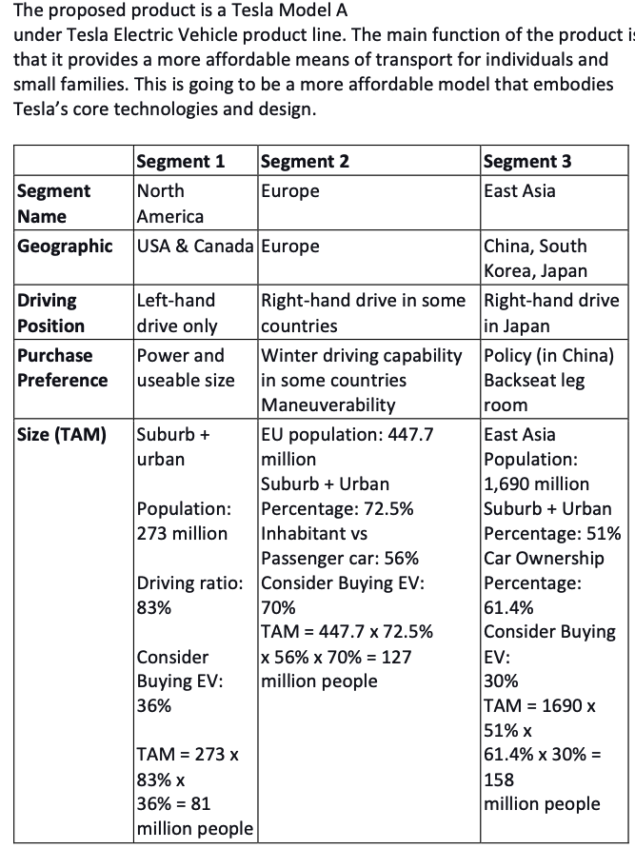
Example: New Tesla Electric Vehicle (former student, a few years ago)
good

Slide 40

Example: Market sizing approach
Reference
Market Segment: Avid Skiers in the USA
For a new high performance ski bindings product
Top-Down
How many adults are there in the USA?
Multiple this by the percentage of Americans who ski?
Assume that adult skiers buy new skis every 5 years to get the number pairs sold per year
Estimate a percentage of skis onto which this new binding could be sold
Bottom-Up
See market leaders to find the number of skis sold in the USA last year. How many are estimated for this year and next year?
Estimate a percentage sold to adults (remove the amount sold to children)
Estimate a percentage of skis onto which this binding could be sold.

Slide 41
The End

